Slide 1
Trends in Beer Preferences
Recommendations
Andrew Graham

Slide 2
Introduction
This Dataset contains 1.5M reviews of beer scrapped from BeerAdvocates.com
What can we learn about the scoring of these beers?
Can we gain insights on trends on scores for beers?
Can we produce useful recommendations?

Slide 3
Overview
This project will clean the beer review dataset, analyze the feature, group beers using cluster analysis, then create recommendations using both content and collaborative models
Data Preparation
Exploratory
Analysis
Models and
Recommendations

Slide 4
Data Preparation
Data Overview
Data Cleaning

Slide 5
Data Overview
Dataset Numbers
Features
Number of Reviews: 1,586,251
Number of Breweries: 5,838
Number of Reviewers: 33,387
Number of Beer Styles: 104
Number of Beers: 66,040
Number of Cities: 3,799
Scores (Numerical)
Overall, Aroma, Appearance, Taste, Palette
Scale: 0-5
Beer ABV (Numerical)
Beer, Beer Style
Brewery, Location (Added)
Reviewer, Review Time

Slide 6
Data Preparation
Cleaning
Adding Location
No duplicates
Brewery Name: 15 NA
Removed Rows
Review Profile Name: 248 NA
Removed Rows
Beer ABV: 67,785 NA
Imputed Mean ABV by Beer Style
Timestamp converted to DateTIme
PROBLEM
Beers and Breweries had mismatches on counts between their name and IDs
Mismatch comes from multiple Brewery locations having the same name
SOLUTION
Beer ID and Brewery ID lead to page on Beeradovacates.com
Scrape Beeradvocates and add Location to Dataframe

Slide 7
EDA
User Reviews
Scoring
Aggregating Scores
Beer
Breweries
Location

Slide 8
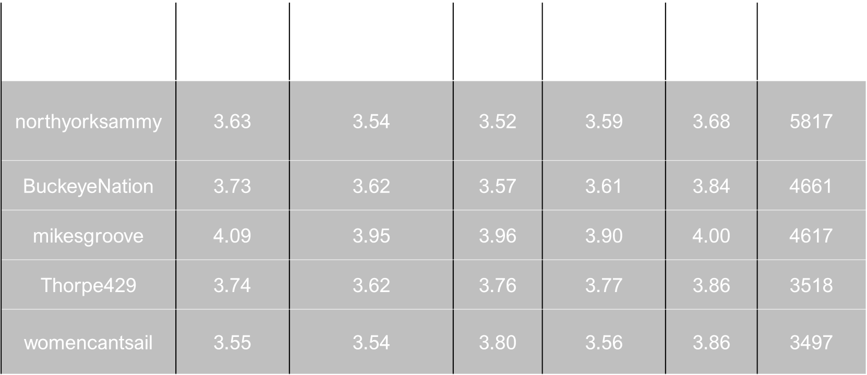
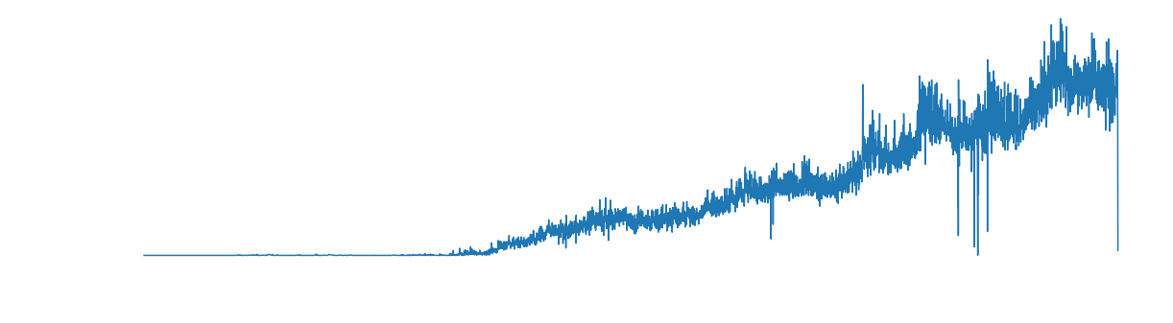
EDA - Reviewers
Reviewer Statistics
Number of Reviewers: 33,387
Average # Reviews per Reviewer: 3
Reviewers with 1 reviews: 10,443 ~33%
Reviewers with 1-10 reviews: 12,755 ~33%
Reviews with over 10 reviews: 10,189 ~33%
252 Reviewers with over 1000 reviews
Reviews Range from 1996-2012

Slide 9
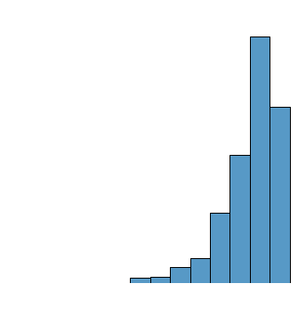
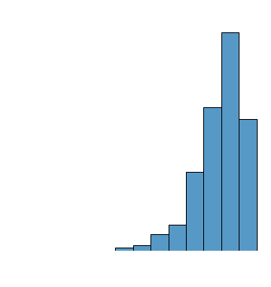
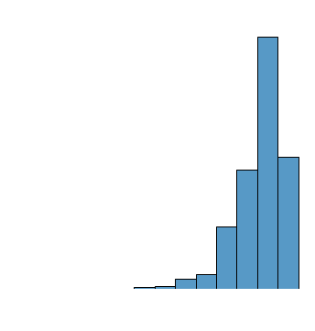
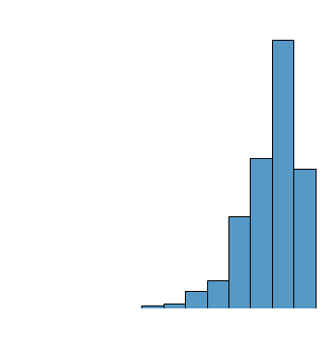
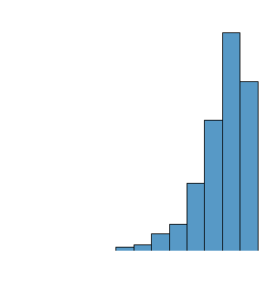
EDA - Scoring
Score | Mean | Median | Min | Max
Overall | 3.82 | 4.00 | 0.00 | 5.00
Aroma | 3.74 | 4.00 | 1.00 | 5.00
Appearance | 3.84 | 4.00 | 0.00 | 5.00
Palate | 3.74 | 4.00 | 1.00 | 5.00
Taste | 3.79 | 4.00 | 1.00 | 5.00

Slide 10

Which of the factors (taste, aroma, appearance, palate) are most important in determining the overall quality of a beer?
Correlations
Taste is most Important
Score | Correlation with Overall
Taste | 0.79
Palate | 0.70
Aroma | 0.62
Appearance | 0.50

Slide 11
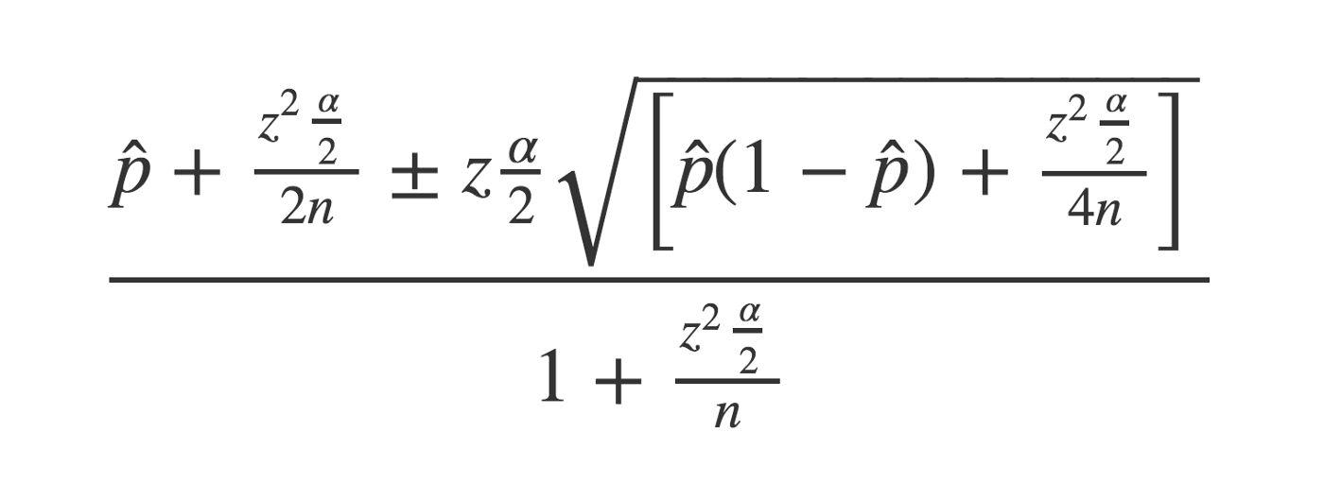
EDA – Aggregating Scores Lower Bound of Wilson Score Confidence Interval:
Problem
Solution
We need to balance the proportion of positive ratings with the uncertainty of a small number of observations
Given the ratings I have, there is a 95% chance that the “real” fraction of positive ratings is at least what?
We will assume scores >=3 as positive
Apply Wilson Score Confidence Interval to Beer Recommendations to provide more reliable scores that take into account the number of reviews

Slide 12
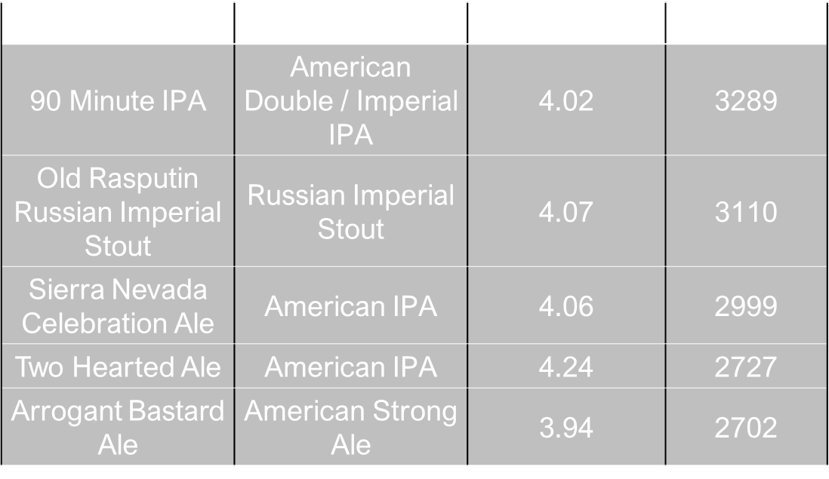
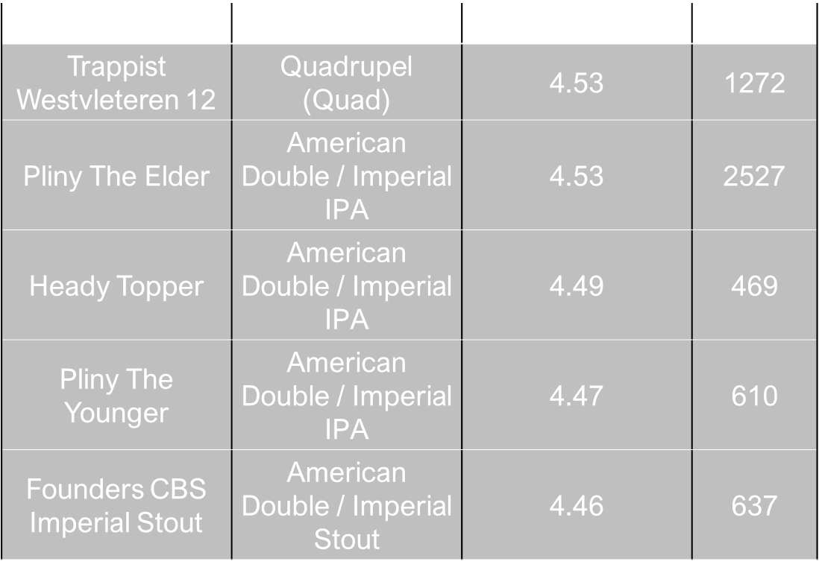
EDA - Beers
Reviewer Statistics
Number of Beers: 64,484
Average # Reviews per Beer: 24.41
Average Overall Score: 3.65
Average ABV: 6.23
Max 57.7, Min 0.01
Beers with 1 review: 23,049

Slide 13
EDA – Beer Styles
Beer Statistics
Style | Review
American Wild Ale | 3.98
Quadrupel (Quad) | 3.97
Gueuze | 3.95
Russian Imperial Stout | 3.92
American Double / Imperial Stout | 3.9
Number of Styles: 104
Average # Reviews per Style: 15,252
Average Number of Beers: 566.16
Average Overall Score: 3.47
Average ABV: 6.45
Max 11.39, Min 0.57

Slide 14
EDA – Brewery
Brewery Statistics
Brewery | Location | Overall Review
Brouwerij Westvleteren (Sint-Sixtusabdij van W... | Westvleteren, Belgium | 4.48
The Alchemist | Waterbury, VT | 4.45
Russian River Brewing Company | Santa Rosa, CA | 4.33
Bayerische Staatsbrauerei Weihenstephan | Freising, Germany | 4.22
Hill Farmstead Brewery | Greensboro Bend, VT | 4.20
Number of Breweries: 5,804
Average # Reviews per Brewery: 271
Average Number of Beers: 11.1
Average number of styles: 7.39
Most Reviewed: Sam Adams
Highest Beer Selection: John Harvard's Brewery & Ale House

Slide 15
EDA - Location
Country | Overall Score | Number of Reviews | Number of Beers | Number of Breweries
United States | 3.69 | 1148130 | 35464 | 2288
Belgium | 3.86 | 118177 | 2039 | 185
Germany | 3.78 | 66010 | 2548 | 614
Canada | 3.48 | 52843 | 3668 | 297
England | 3.66 | 51932 | 2602 | 416

Slide 16
Modeling and Recommendations
Clustering Analysis
Content Based Recommendations
Collaborative Recommendations

Slide 17
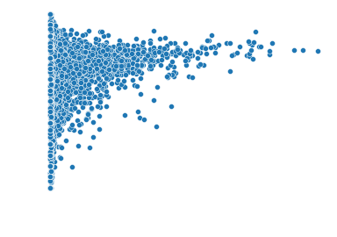
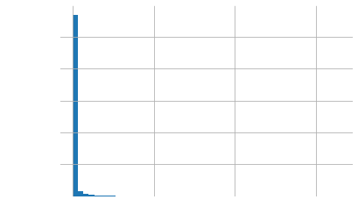
Clustering Analysis
Assumptions
Using K-Means Clustering
Looking for rating patterns to group Beers
Use data grouped by beers
Use Overall Rating
Other Ratings correlate so will be skipped
Use Number of reviews
Transform to sqrt as data is skewed
Use mean to aggregate scores as number of reviews is already in model

Slide 18
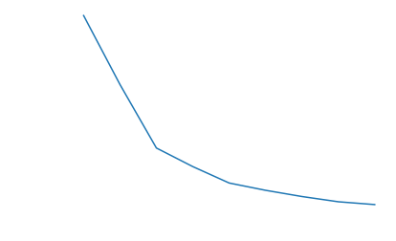
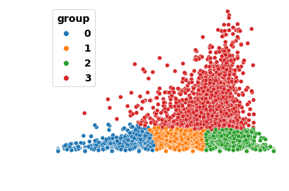
Clustering Analysis
Model
K-means
Using k value of 4 based on elbow plot
Scaled using StandardScaler
Results
Group 0: Low score, Low reviews
Group 1: Mid Score, Low Reviews
Group 2: High Score, High Reviews
Group 3: High Reviews

Slide 19
Clustering Analysis
Group | Beer | Style | Brewery | Overall Review | Number of reviews
3 | 90 Minute IPA | Dogfish Head Brewery | American Double / Imperial IPA | 4.15 | 3289
3 | Sierra Nevada Pale Ale | Sierra Nevada Brewing Co. | American Pale Ale (APA) | 4.25 | 2587
3 | Stone IPA (India Pale Ale) | Stone Brewing Co. | American IPA | 4.26 | 2574
2 | King Henry | Goose Island Beer Co. | English Barleywine | 4.62 | 98
2 | Ola Dubh Special Reserve 40 | Harviestoun Brewery Ltd. | Old Ale | 4.16 | 96
2 | Red Eye Coffee Porter | Two Brothers Brewing Company | American Porter | 4.15 | 95
1 | Odd Notion (Winter 09) | Magic Hat Brewing Company | American Wild Ale | 2.86 | 111
1 | Yanjing Beer | Beijing Yanjing Beer Group Corporation | American Adjunct Lager | 2.86 | 109
1 | It's Alright! | Mikkeller ApS | Belgian Pale Ale | 2.79 | 107
0 | Keystone Ice | Coors Brewing Company | American Adjunct Lager | 2.33 | 139
0 | Bud Extra | Anheuser-Busch | Herbed / Spiced Beer | 1.95 | 128
0 | Michelob Celebrate Vanilla Oak | Anheuser-Busch | American Pale Lager | 2.5 | 109

Slide 20
Recommendations
Content Based
Collaborative
Recommend items based on user's history and preferences
Use item metadata to generate recommendations
Rely on explicit or implicit user feedback
Recommendations are specific to the user's taste and preferences.
Recommend items based on the behavior and preferences of other users
Look for patterns and similarities in user behavior
Recommend items that are popular or well-liked by similar users
Recommendations are based on the collective preferences of a group of users.

Slide 21
If you had to pick five beers to recommend, which would you pick?
Beer Style | Beer | Brewery | # of Reviews | Overall Score
Quadrupel (Quad) | Trappist Westvleteren 12 | Brouwerij Westvleteren (Sint-Sixtusabdij van W... | 1272 | 4.53
American Double / Imperial IPA | Pliny The Elder | Russian River Brewing Company | 2527 | 4.53
American Double / Imperial Stout | Founders CBS Imperial Stout | Founders Brewing Company | 637 | 4.46
Hefeweizen | Weihenstephaner Hefeweissbier | Bayerische Staatsbrauerei Weihenstephan | 1980 | 4.44
Dubbel | Trappist Westvleteren 8 | Brouwerij Westvleteren (Sint-Sixtusabdij van W... | 707 | 4.39
Content Based
Broad and general
Provide options in style
Use weighted score to prefer popular
Use popular group
Take 5 highest rated from 5 styles

Slide 22
If I usually enjoy IPAs, which beer should I try?
Content Based
Beer | Brewery | # of Reviews | Overall Score
Pliny The Elder | Russian River Brewing Company | 2527 | 4.53
Heady Topper | The Alchemist | 469 | 4.49
Pliny The Younger | Russian River Brewing Company | 610 | 4.47
Find beers with IPA style
Take Highest Rated
Use weighted scores
Can use groups if you want recommend more known or less known beers
Beer | Brewery | # of Reviews | Overall Score
Double Sunshine IPA | Lawson's Finest Liquids | 85 | 4.20
Galaxy Imperial Single Hop IPA | Hill Farmstead Brewery | 76 | 4.17
India Pale Ale | Selin's Grove Brewing Company | 84 | 4.05

Slide 23
If I enjoy Shiner Bock, what would other people who like it recommend?
Collaborative
Beer | Style | Brewery | # of Reviews | Overall Score
Weihenstephaner Hefeweissbier | Hefeweizen | Bayerische Staatsbrauerei Weihenstephan | 88 | 4.18
Pliny The Elder | American Double / Imperial IPA | Russian River Brewing Company | 71 | 4.09
La Fin Du Monde | Tripel | Unibroue | 111 | 4.03
Find all users who rated this beer highly
Remove all users who only reviewed this one beer
Get aggregate scores of other beers
Can Incorporate similar beers such as same style
Beer | Style | Brewery | # of Reviews | Overall Score
Samuel Adams Winter Lager | Bock | Boston Beer Company (Samuel Adams) | 118 | 3.39
LongShot Traditional Bock | Bock | Boston Beer Company (Samuel Adams) | 36 | 3.16
Anchor Bock Beer | Bock | Anchor Brewing Company | 38 | 3.13

Slide 24
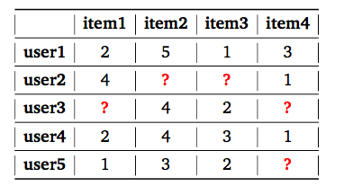
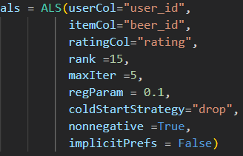
Based on beers I like, what other beers would users recommend?
Collaborative ALS Model
Creating the Model
Using PySpark for Distributed Computing
Matrix factorization-based approach to generate recommendations
Can handle large scale, sparse, and implicit feedback datasets.
Will use review dataset
Username
Beer
Overall Score
Filter out users and beers with <10 reviews
Creates matrix 99.07% empty
RMSE 0.6

Slide 25
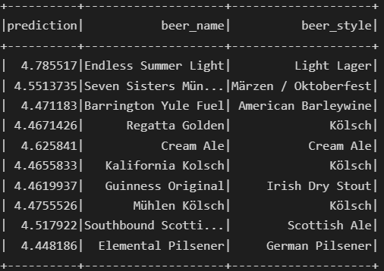
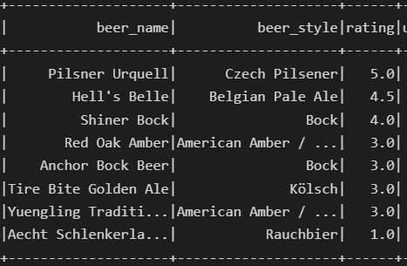
Based on beers I like, what other beers would users recommend?

Slide 26
Next Steps
Dataset
Scrape for more current Data
Location Analysis
Integrate Beer Profile data if available
Interactive Dashboards
Models
Create Hybrid Model of Content and Collaborative Models
Tune ALS models (Need more computing Power)
Create App for users to get recommendations

Slide 27
Breakdown
Data Preparation ~40%
Visualization and Analysis ~40%
Models ~20%
Setting up PySpark to run locally on my machine? ~Eons

Slide 28
Questions?

